Slide 1

Progress Seminar on BTS FANPAGE
Presented By
Ms. Shubhangi Chaudhary
Guided By
Mrs. Roshani Talmale
Department of Computer Science & Engineering
S. B. JAIN INSTITUTE OF TECHNOLOGY MANAGEMENT AND RESEARCH,NAGPUR
An Autonomous Institute, Affiliated to RTMNU, Nagpur

Slide 2
Contents
Problem Statement & Objectives
Introduction
Literature Survey
Website Design
Technology to be Used
Modules
Screenshots
Advantages & Applications
References
S. B. Jain Institute of Technology Management and Research
2

Slide 3
Problem Statement & Objectives
Problem Statement:
Nowadays there are lots of followers of the South Korean Group BTS and many people aren’t aware about who they are, that’s why I created a fanpage to get people know about the World’s Biggest Boyband i.e. BTS.
Objectives:
To Reduce efforts of users.
To Provide full satisfaction to the user.
To Provide easy access to the user.
3
S. B. Jain Institute of Technology Management and Research

Slide 4
Introduction
For this project, I worked on Web Development by creating a website named as BTS-Fanpage in which I used HTML, CSS and JS programing language . Users will be able to use the website to know about BTS . In this website I created different sections / pages for detailed information about Bangtan Sonyeondan (BTS) linked with different websites so that users will have more options to visit to get as much as information they want to know.
Users can access websites on a range of devices including desktops, laptops, tablets, and smartphones.
S. B. Jain Institute of Technology Management and Research
4

Slide 5
Literature Survey
Websites / Paper / Article | Reviews / Findings
www.btsdiary.com | 1. Contents are good. 2. Pages are appropriate.
www.usbtsarmy.com | Well designed website. Animations are also used. Can attract the user.
www.bts.fandom.com | 1. Styling was not so good.

Slide 6
Website Design: Flowchart
Start
Home Page
Menu Btn
Visit To know more
Official website
Home
About
Members
Videos
YouTube
Gallery
New Tab
Stop

Slide 7

Use case Diagram
Start
View Menu
Select Page
View Page
Visitor
Visit Link
Close

Slide 8
Technology to be Use
Front End:
HTML, CSS, JS
IDE:
VS Code
Hardware used:
Laptop and smartphone
S. B. Jain Institute of Technology Management and research
8

Slide 9
Modules
Module Names
About
Members
Videos
Gallery
Visit To Know More
S. B. Jain Institute of Technology Management and Research
9

Slide 10
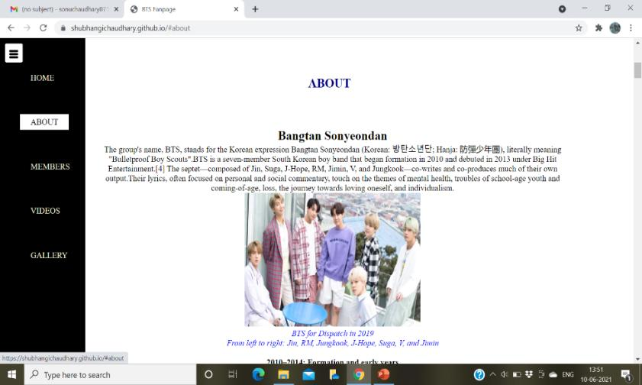
ABOUT
In about section, there are some information about BTS like Who they are? When did they debuted? and so on.
Given below is the screenshot of 1st page of about.

Slide 11
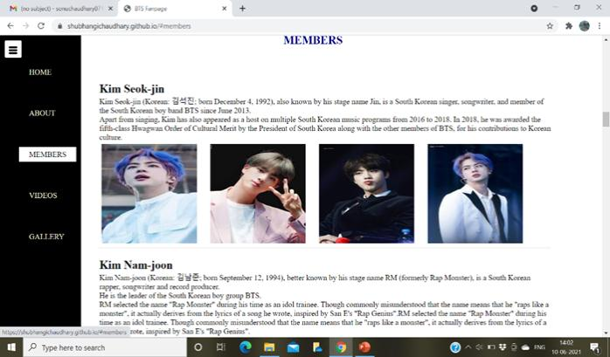
MEMBERS
In members section, there are some description about each members of BTS with their images.
Given below is the screenshot of one of the member of BTS.

Slide 12
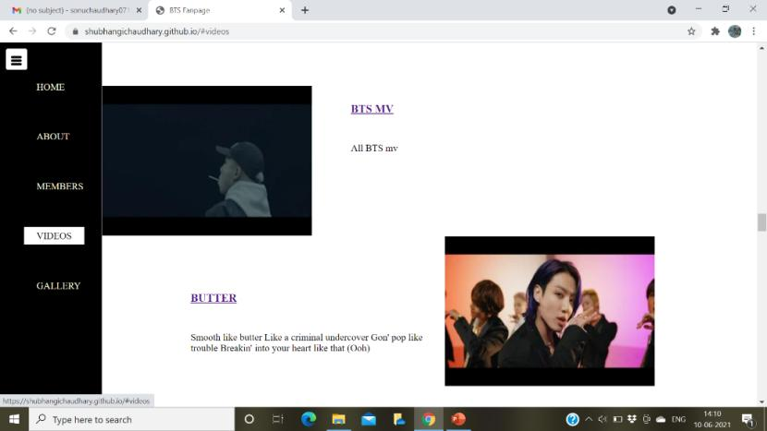
VIDEOS
In videos section, there are various videos of BTS such as their mv’s, their run bts episodes and etc.
Given below is the screenshot of 1st page of videos.

Slide 13
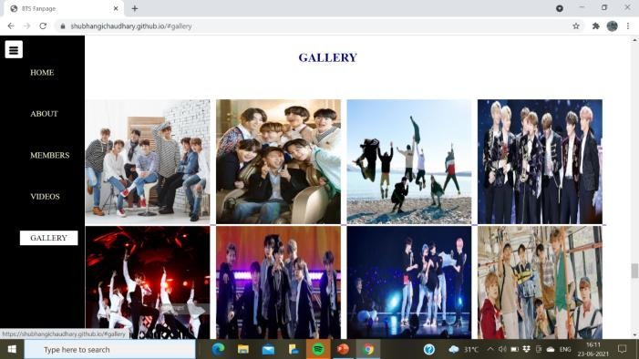
GALLERY
In gallery section, there are all types of group photo of BTS when they were performing on stage, their photoshoot, in award show, etc.
Given below is screenshot of some images.

Slide 14
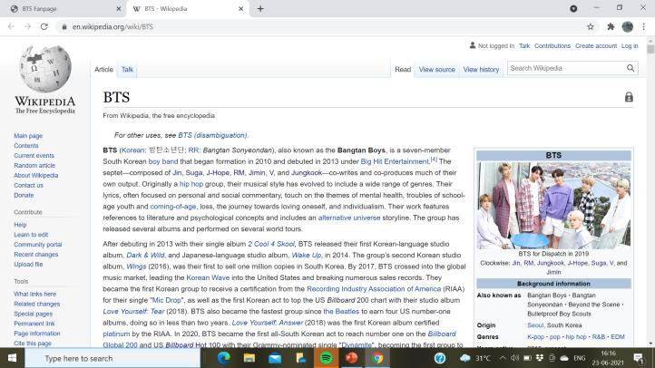
VISIT TO KNOW MORE
From visit to know more button, visitor will visit to a page of Wikipedia of BTS to get more information.

Slide 15
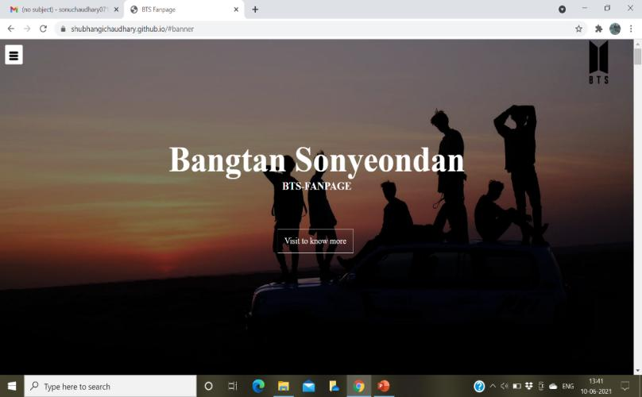
Screen Shots
Home Page
S. B. Jain Institute of Technology Management and Research
15

Slide 16
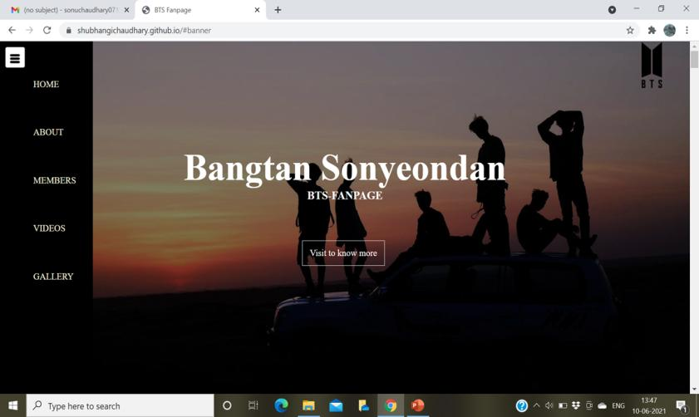
Menu Bar
S. B. Jain Institute of Technology Management and Research
16

Slide 17
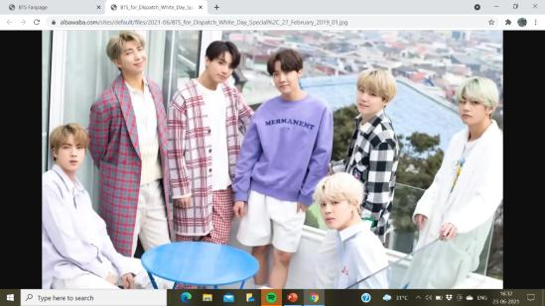
About
CLICK

Slide 18
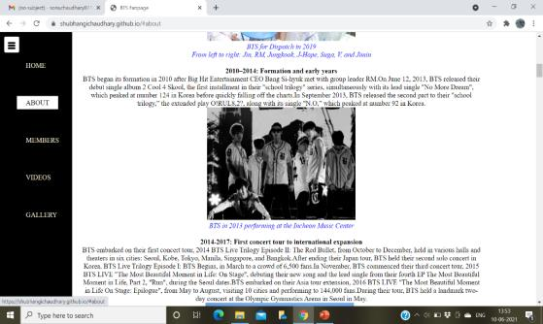
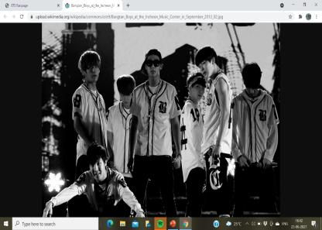
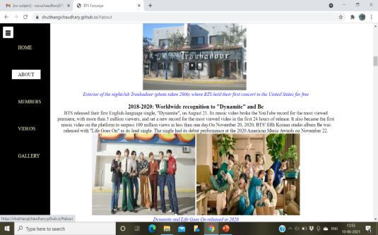
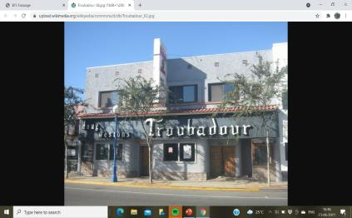
CLICK
CLICK

Slide 19
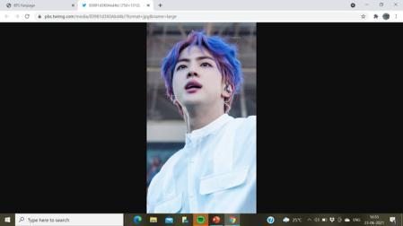

Members
CLICK

Slide 20
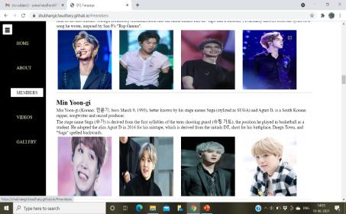
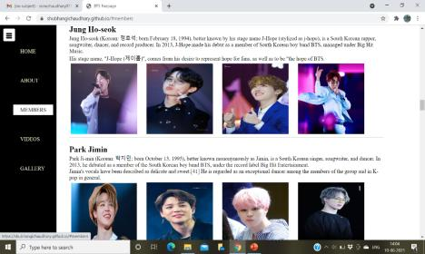
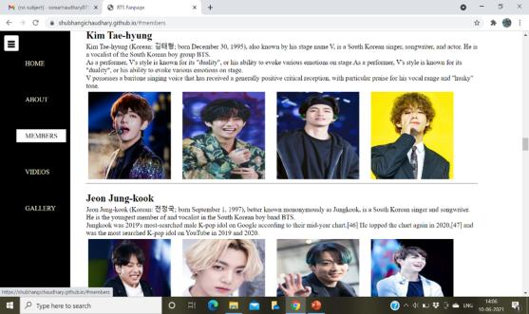

Slide 21
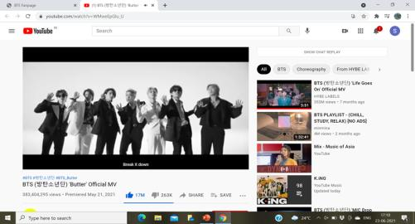
Videos
CLICK

Slide 22
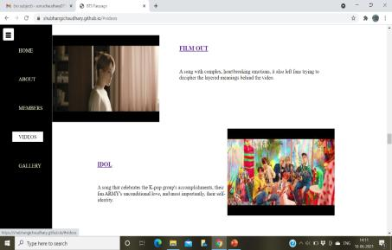
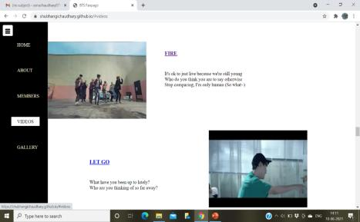
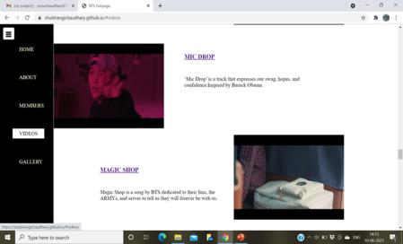
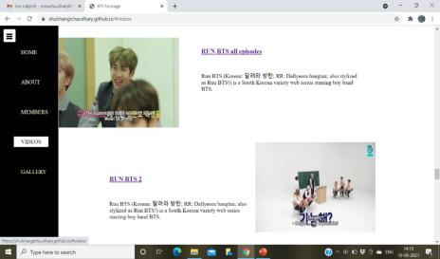

Slide 23
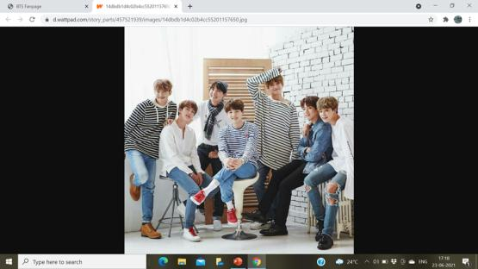
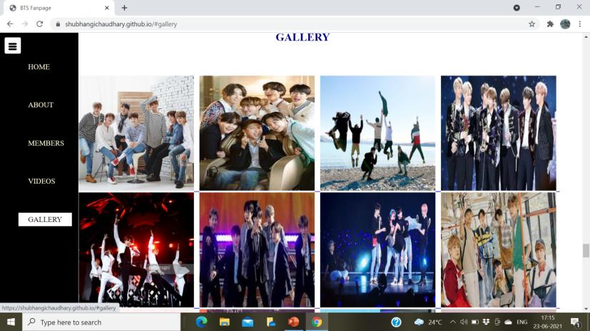
Gallery
CLICK

Slide 24
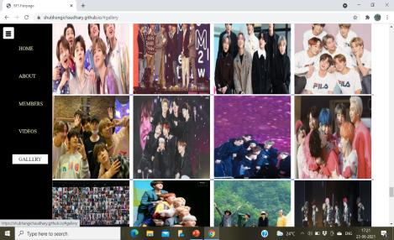
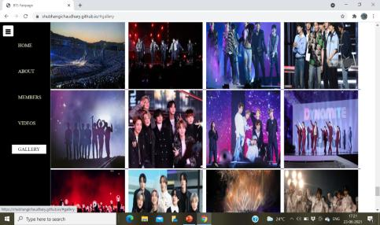
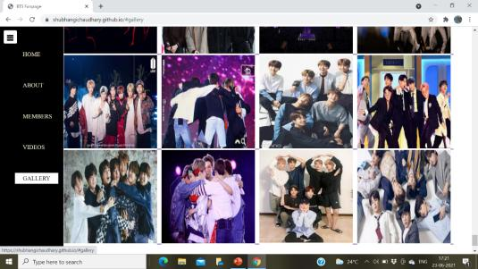

Slide 25
Advantages & Applications
By consistently updating the fanpage we can keep our users or visitors informed and remain relevant.
Anyone can access the webpage at any time.
Users can get any information about BTS through the links provided in the webpage.
S. B. Jain Institute of Technology Management and Research
25

Slide 26
References
Websites:
www.w3schools.com
www.sololearn.com
www.greatlearning.com
S. B. Jain Institute of Technology Management and Research
26

Slide 27
Thank You

